Slide 1
A Simple Lecture Recording Setup
Charles Severance
University of Michigan
School of Information

Slide 2
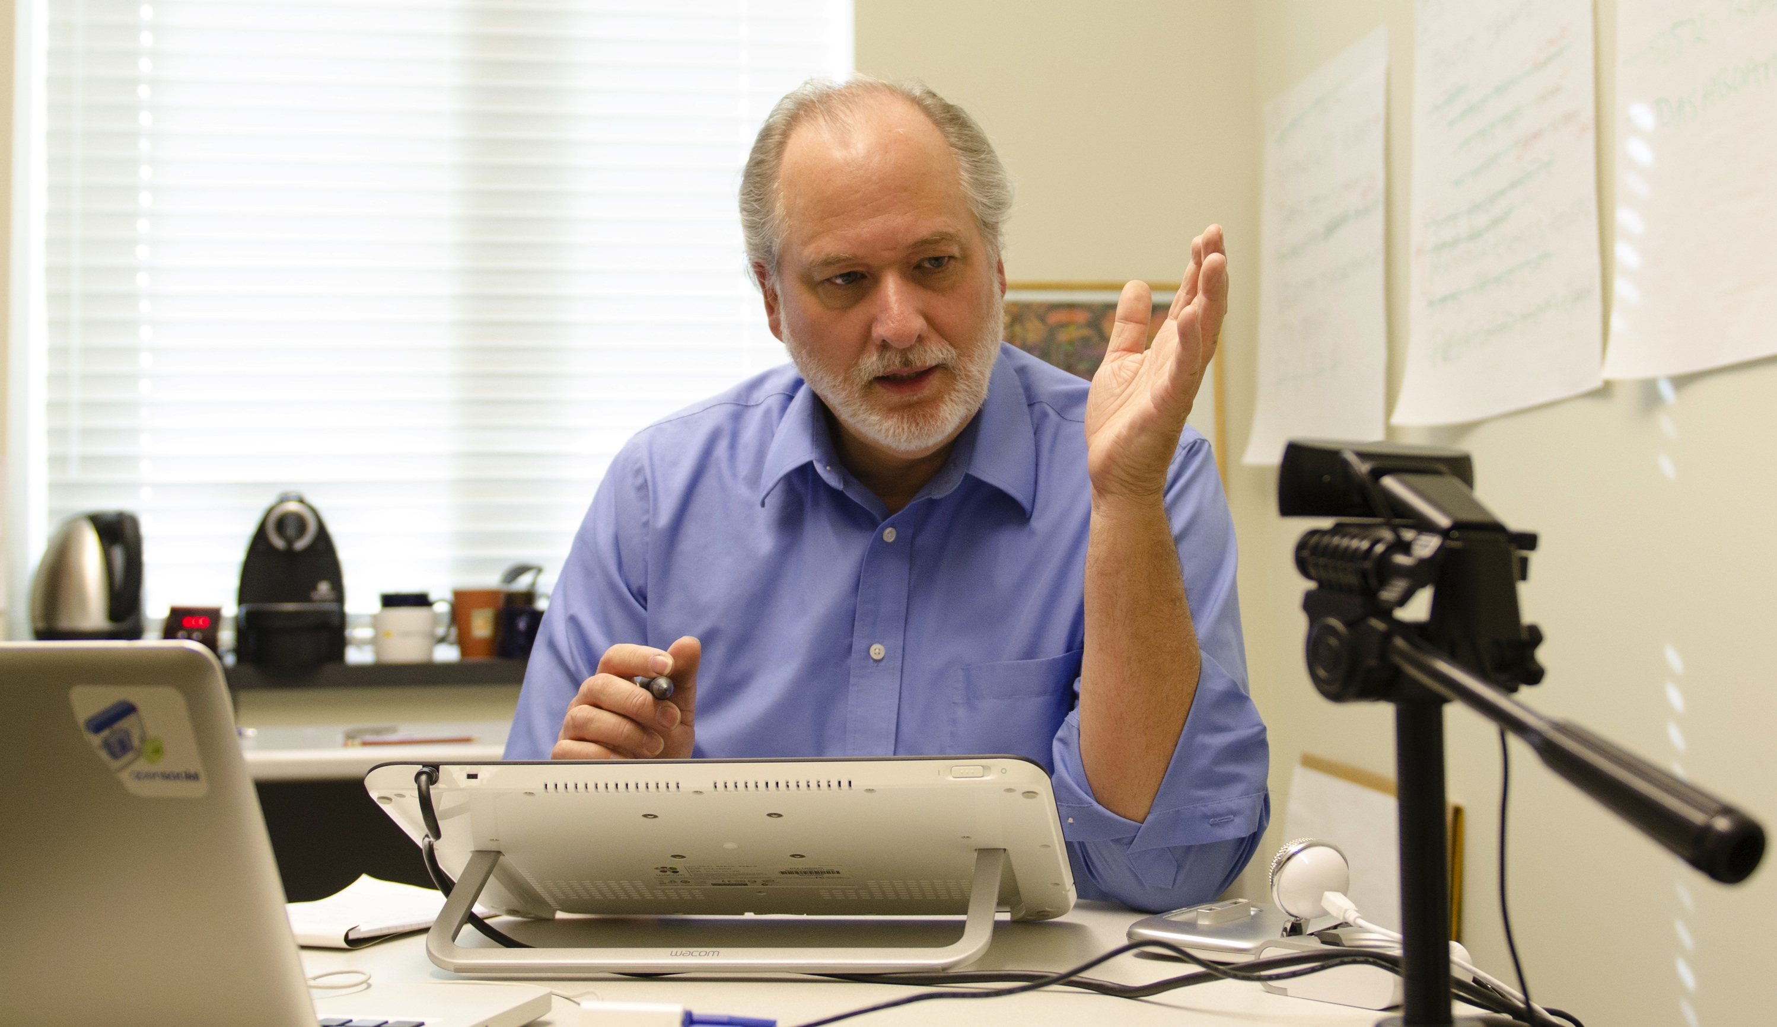
Goals
Video that looks warm and inviting in HD
Ease of recording in office and home office
Off-the-cuff recording
Both for MOOC courses and recorded lectures for F2F

Slide 3
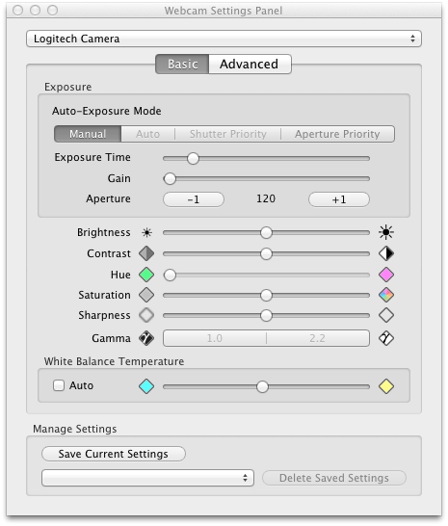
Equipment
MacBook Pro 4 CPU / 8GB RAM
Logitech C920 (Camera + Microphone)
Wacom Cintiq 12WX
Omnidazzle for Drawing
WebCam Settings for Adjusting Camera
Camtasia for Mac

Slide 4
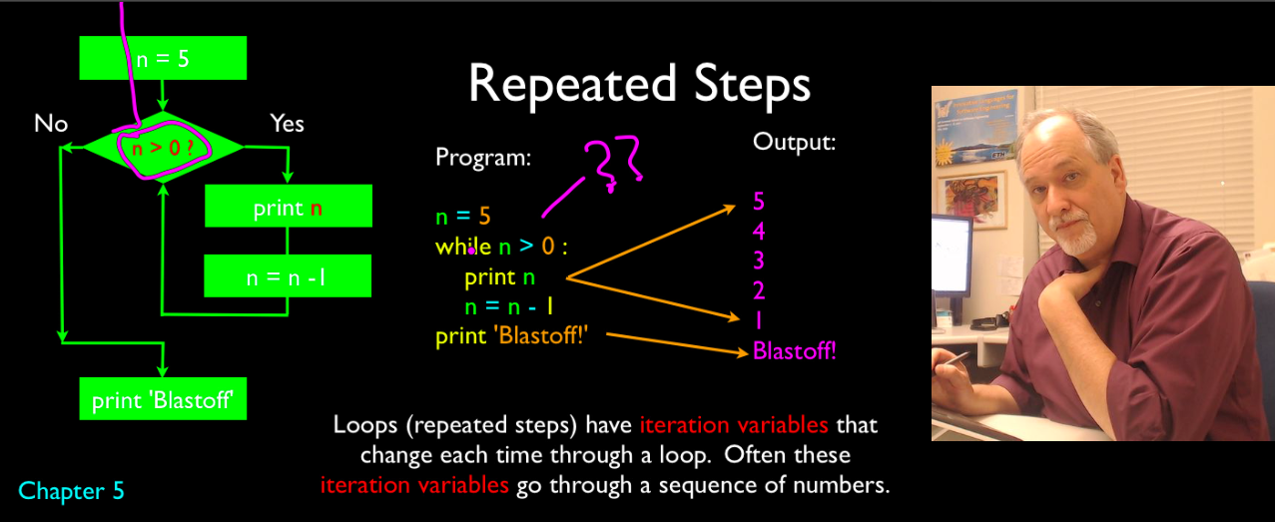
Distance Education Setup – 1280 x 525

Slide 5
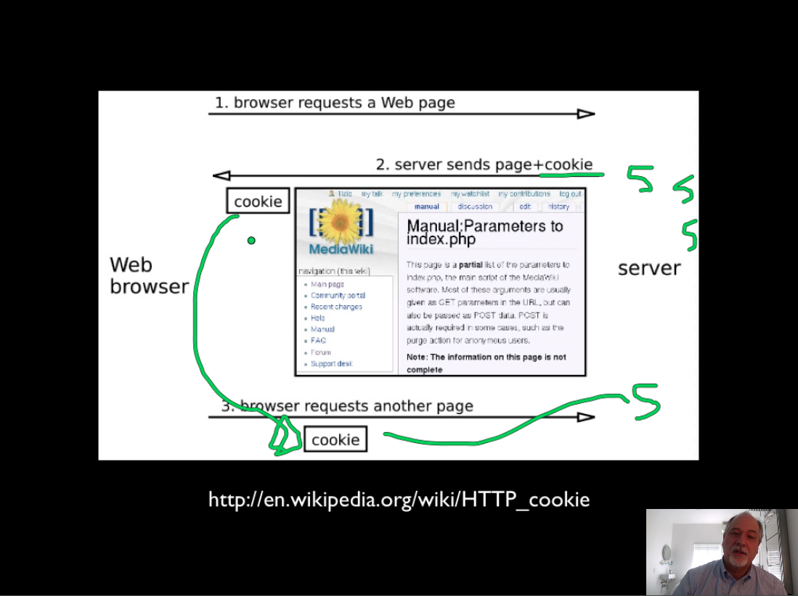
For in-Class play Setup – 1024x768

Slide 6
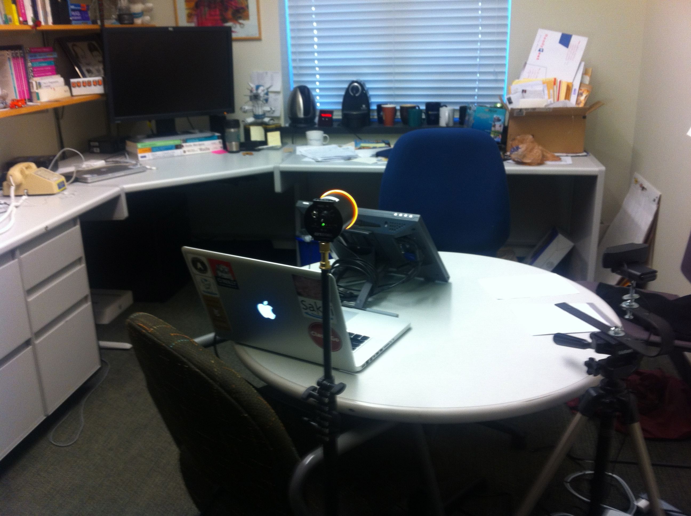
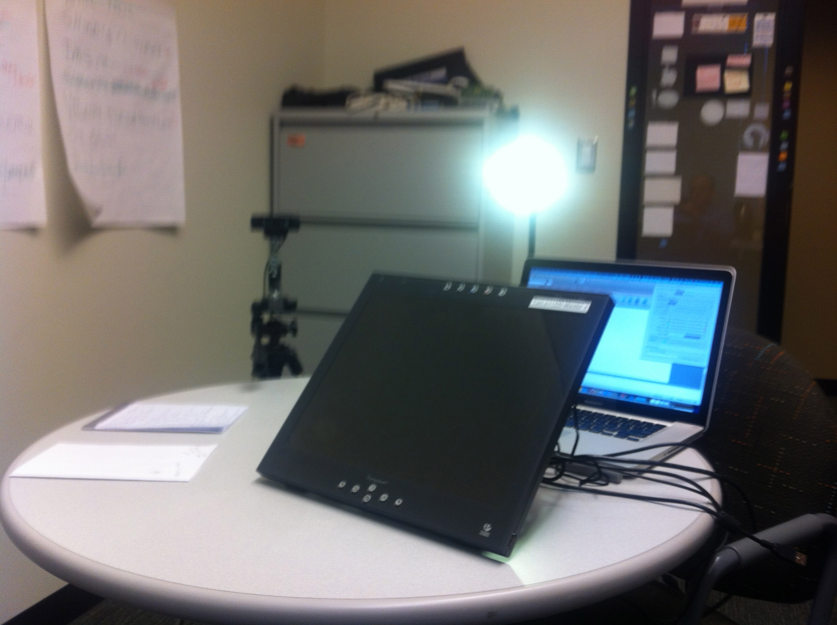
Office Setup

Slide 7
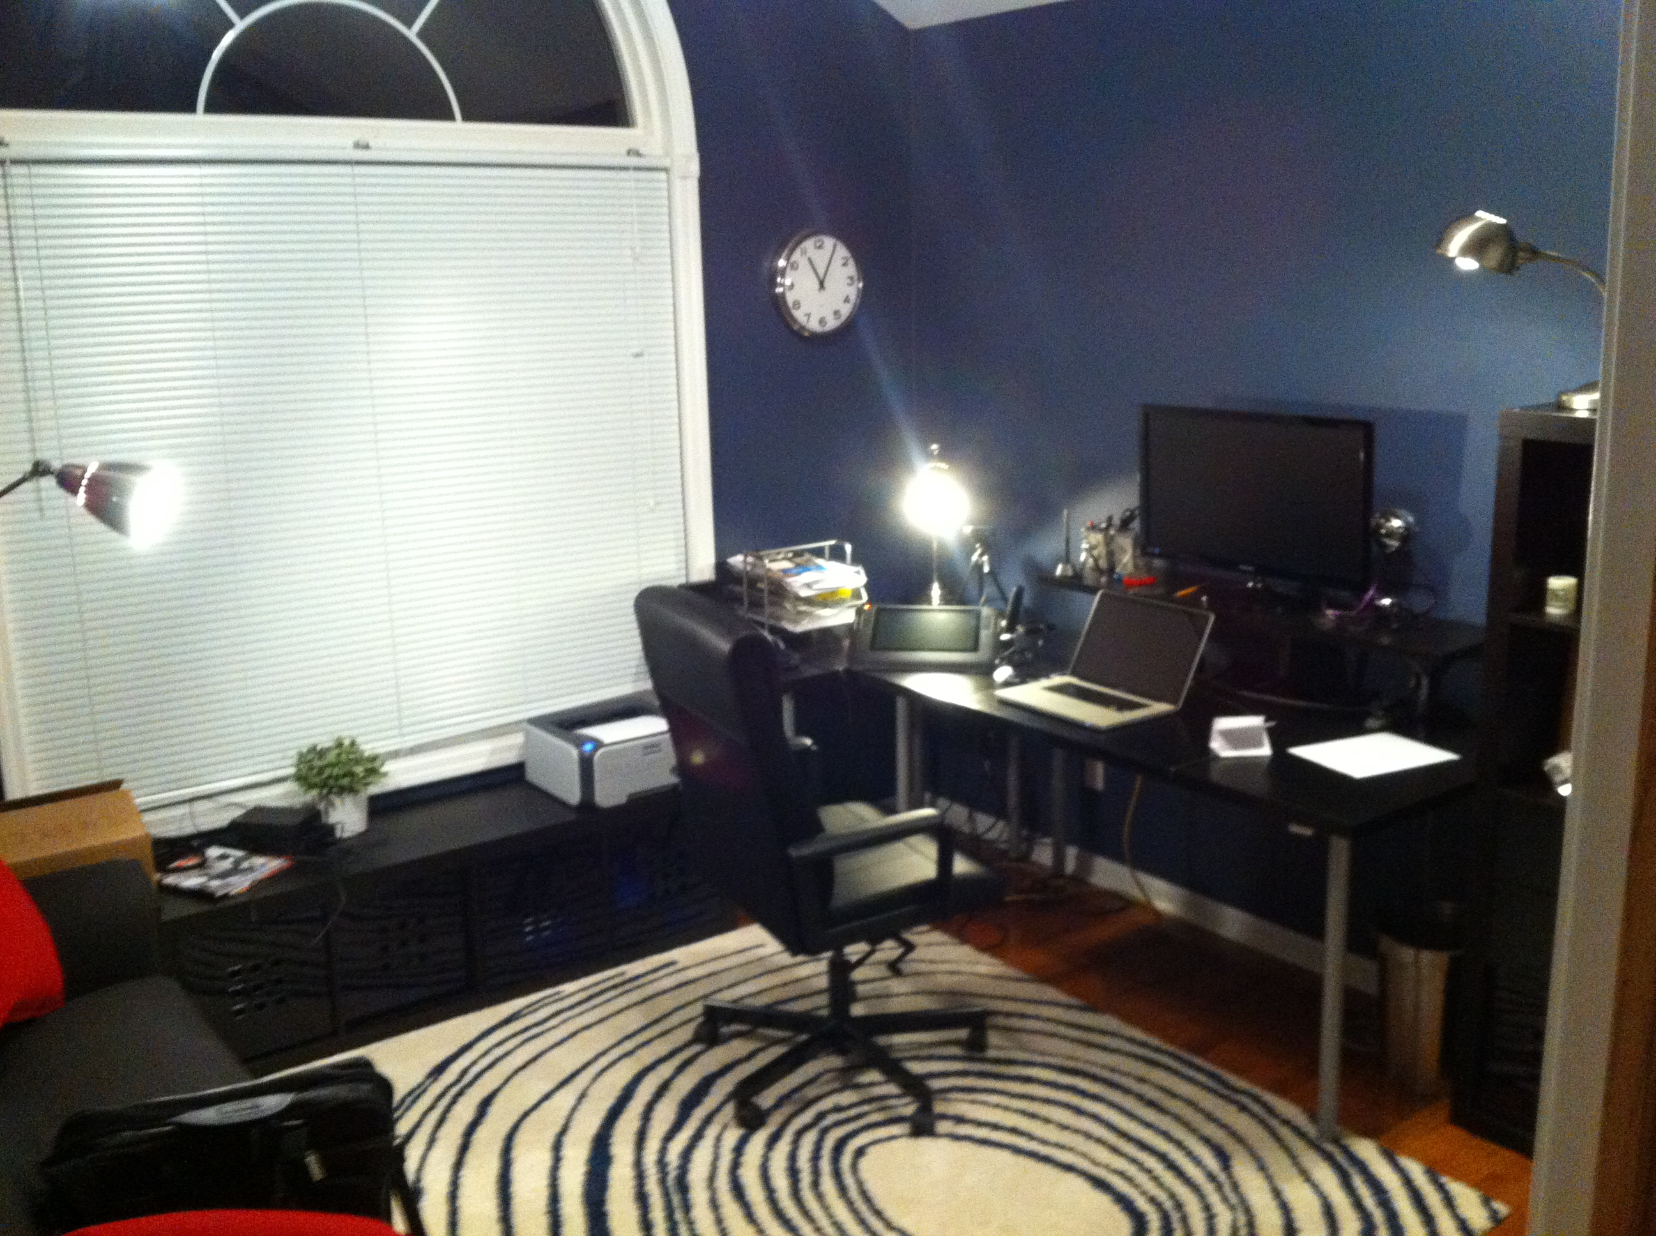
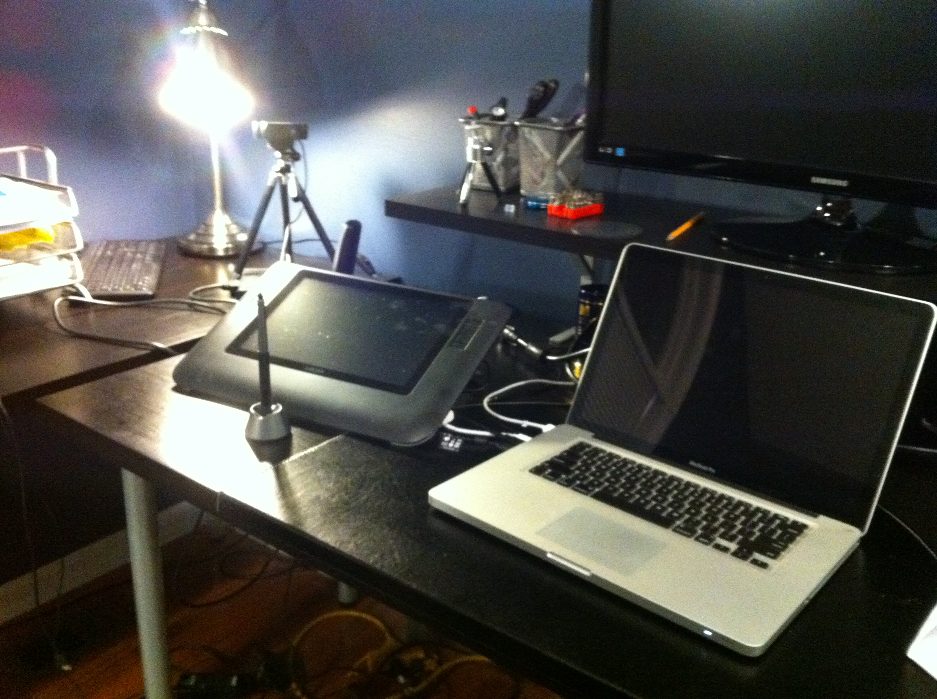
Home Setup

